Slide 1
Seasonality of COVID-19 Cases in los Angeles county, CA
Kavya Rajaputhra

Slide 2
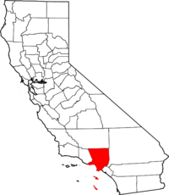
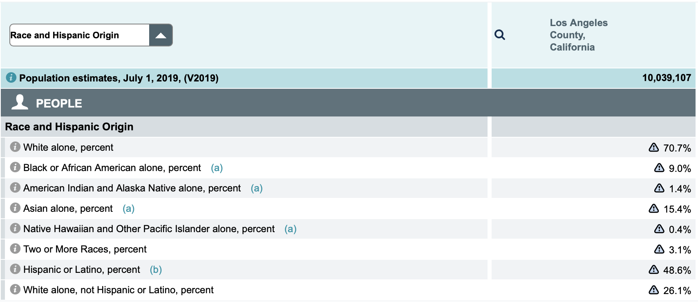
Demographics: Los Angeles County, California
U.S. Census Bureau

Slide 3
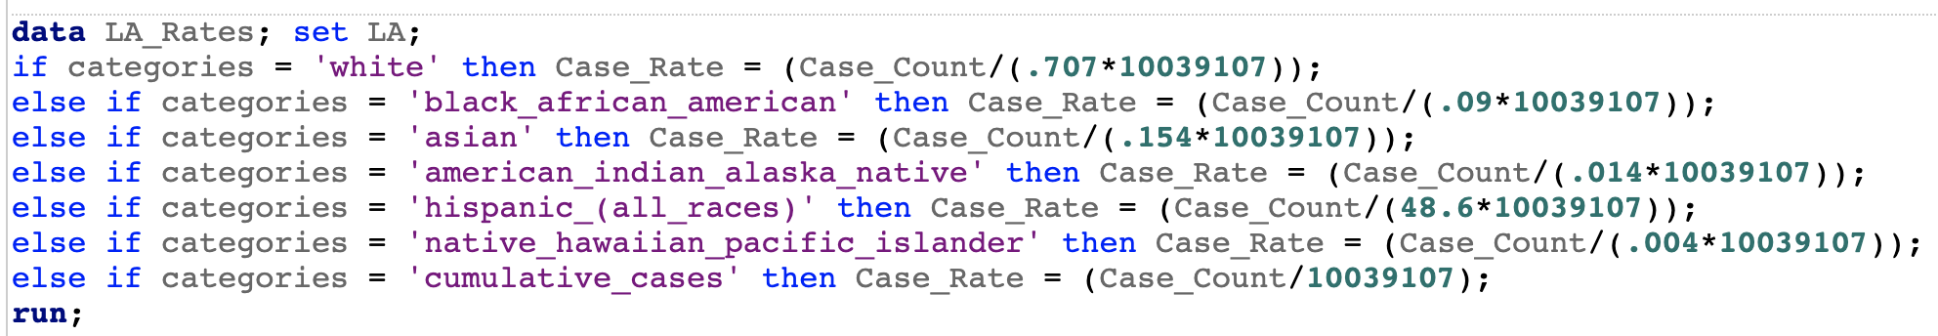
Calculating Covid-19 Case Rate
Case Rate = Case Count / Population
Case Rate = Case Count / Each race’s population
Case Rate = Case Count / (Each race’s % of total population * total population)
SAS onDemand

Slide 4

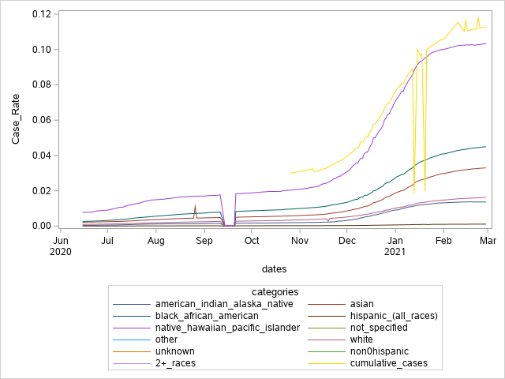
Overall Covid-19 Case Rates by Race
Native Hawaiian and Pacific Islander
African American
Asian
White
American Indian & Alaska Native
Hispanic

Slide 5
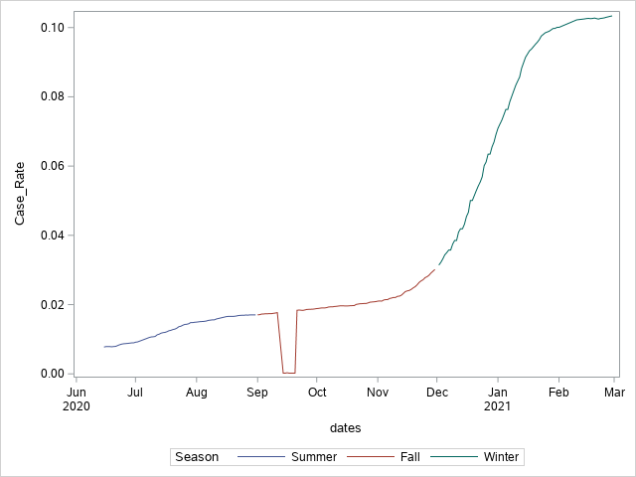
Native Hawaiian/ Pacific Islander
0.4% of LA population
Smallest racial population
Highest COVID-19 rates for all three seasons

Slide 6
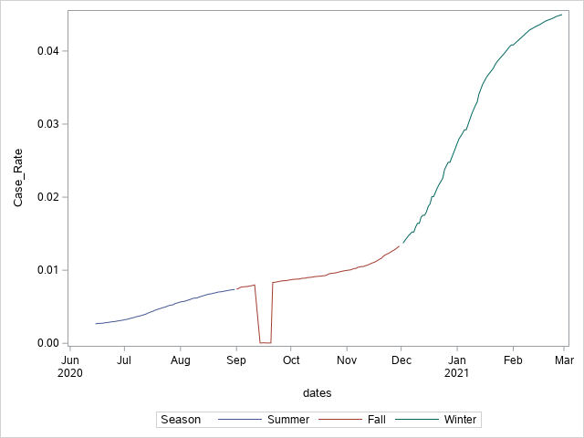
Black
9% of LA population
Third smallest racial population
Higher COVID-19 rates for all three seasons

Slide 7
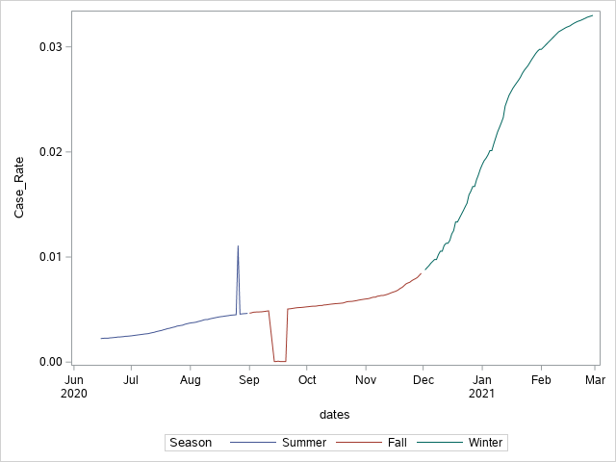
Asian
15.4% of LA population

Slide 8
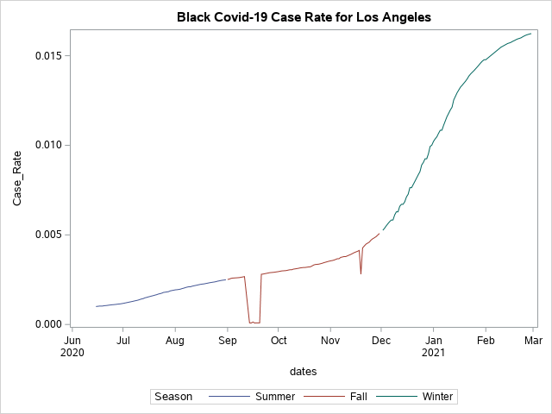
White
70.7% of LA population, including Hispanic whites

Slide 9
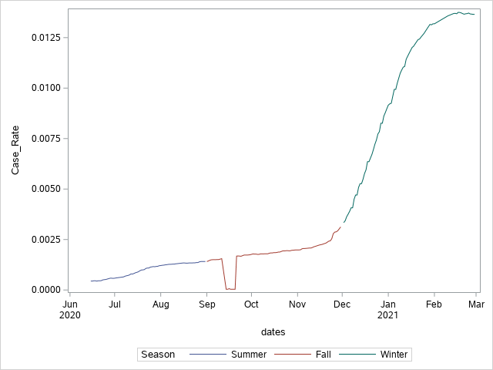
American Indian / Alaska Native
1.4% of LA population
Second smallest racial population
Lower COVID-19 rates for all 3 seasons.

Slide 10
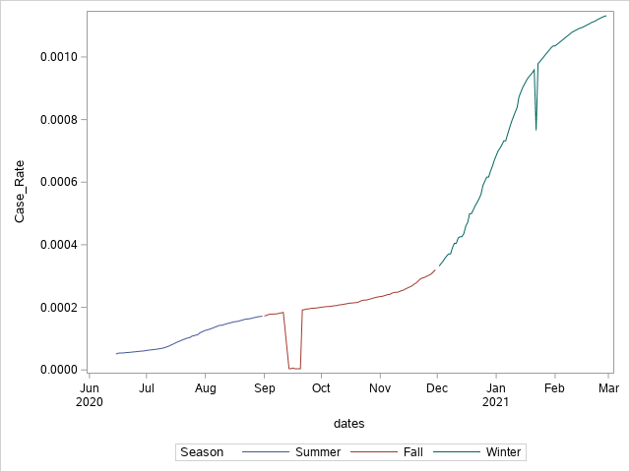
Hispanic/ Latino
48.4% of LA population
Second largest racial population (Largest if not counting Hispanic Whites)
Lowest COVID-19 rates for all three seasons

Slide 11
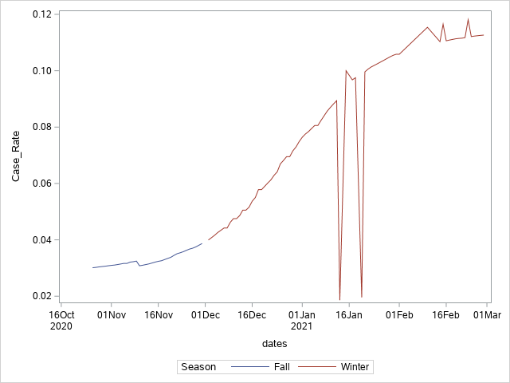
Cumulative
Cumulative case data unavailable for Summer

Slide 12
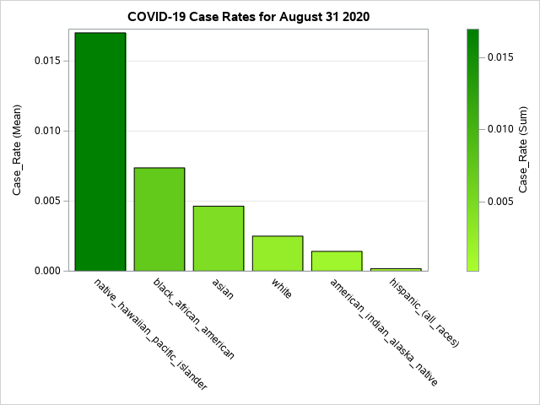
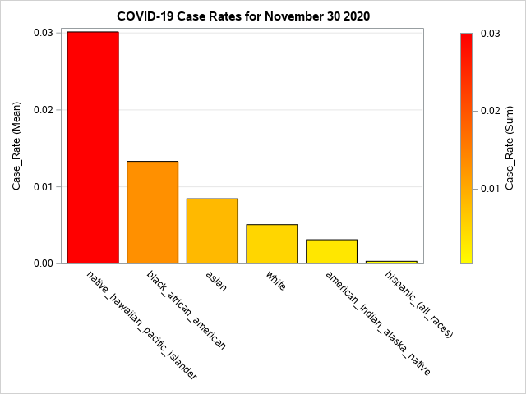
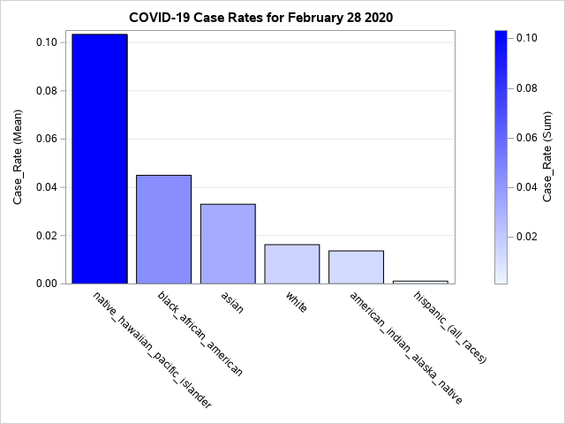
Final Case Rates at end of each Season

Slide 13
CONCLUSION
Rate of COVID-19 infections increased the most during Winter.
Summer had a steady increase in covid case rates, which continued into Fall
In Winter, Covid rates increased exponentially for all races
Began to stabilize around March 2021
Explanation: Effects of travel and large gatherings for the holiday season may explain the sharp increase
Native Hawaiians/Pacific Islanders had the highest rates of COVID-19 infections for all three seasons
Had more than twice the rate of Covid cases compared to the second highest, African Americans.
Explanation: NHPI communities are more culturally inclined to ignore guidelines and congregate in large gatherings for traditional events (UCLA)
Gatherings are highly prioritized in their ways of life.
COVID-19 messaging is not often done in NHPI languages and doesn’t touch on community values, which makes it difficult for NHPI to resonate with.
NHPI and Blacks make up a small % of LA but had the highest rate of covid-19 infections for all three seasons.
(August 2020). COVID-19 exposes how Native Hawaiians and Pacific Islanders face stark health care disparities. UCLA Health. Retrieved from https://www.uclahealth.org/covid19-exposes-how-native-hawaiians-and-pacific-islanders-face-stark-health-care-disparities

